Slide 1
E-commerce sales analytics
Internova week 6 capstone project
By:
Nithya Rajah
Student ID: INST26DA050067
Batch Cohort – Batch’05
Email ID – Nithyarajah05@gmail.com

Slide 2


Data Set & Project Objective
Data set
Subject Matter – E-commerce
Business Focus
Project Goal
107 original records
11 columns
Sales
Profit
Products
Regions
Customer Ratings
Provide business insights
Produce Business recommendations
Find patterns and trends

Slide 3

Data Preparation & exploratory analysis
Tools used: ~ Python ~Excel ~Power BI ~Jupyter Notebook ~SQL ~Git & GitHub
Inspect
The data was checked for missing values, variations in column names, and others
Grouped summaries, correlation checks and IQR-based outlier investigation
Filled missing Quantity and Customer Rating with medians; derived missing Sales from Quantity × Unit Price.
Inspect
Clean
Analyze

Slide 4
Key findings and visual patterns
Category
Electronics is the largest revenue generating category in the dataset
Region
North records the highest sales and profit, while the West records the lowest
Customer Ratings
Average customer ratings is 4.37/5, and profits are strongly positively correlated
Total Sales
158K
Total Profit
17.25K
Product
Laptops lead recorded sales and profit, strongly influenced by one large order

Slide 5
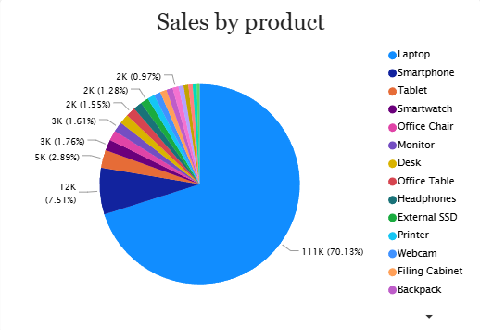
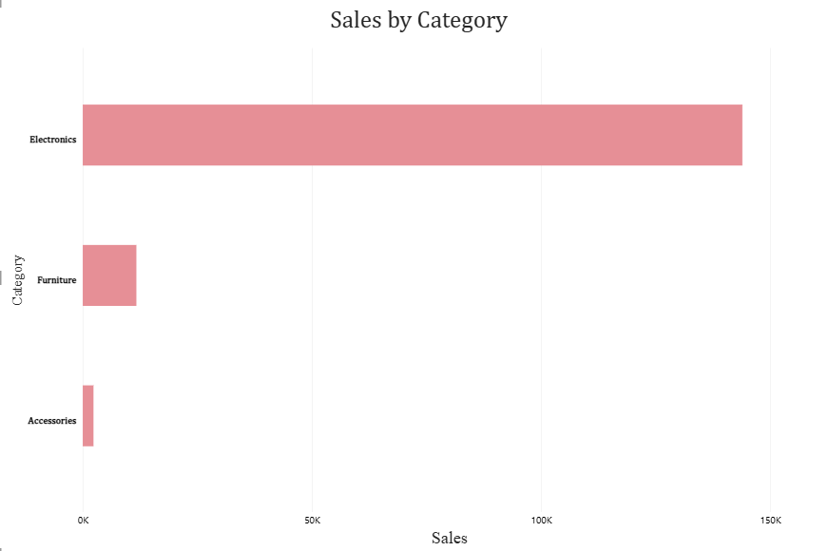
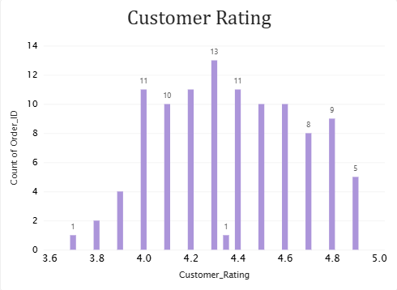
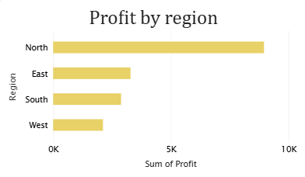
Dashboard and visuals

Slide 6
Business Recommendations
Recommendation 1
Continue monitoring demand for Electronics because it contributes the largest share of sales. Study the practices and customer demand in the North region to identify strategies that may be useful in lower-performing regions
Recommendation 2
Review the unusually large laptop transaction and other potential outliers before using them for business planning. Apply validation rules to flag negative prices, implausible ages, and unusually large order values. Verify these records against source data
Conclusion:
The project demonstrates an end-to-end workflow: prepare data, explore patterns, visualize results, communicate through a dashboard, and document work with GitHub. Findings are useful starting points, subject to data validation

